Slide 1
Social Science Research and Instructional Council (SSRIC)
April 2014

Slide 2
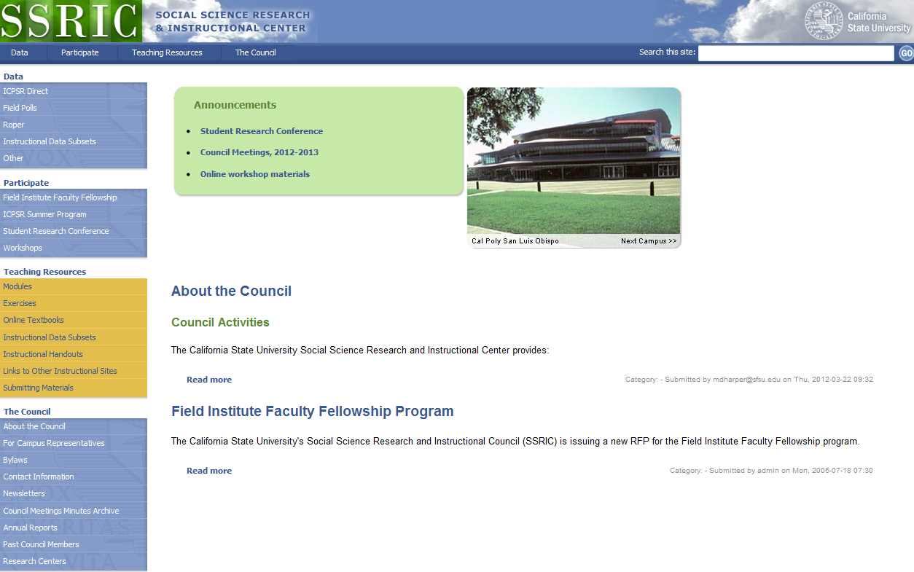
SSRIC

Slide 3
The Council
Oldest CSU affinity group (since 1972)
Promotes use of data analysis in research and teaching
List of teaching resources is available on our website
List of campus representatives to the SSRIC

Slide 4
The Council -- Links
Annual student research conference held in late April or early May
Sponsors travel to ICPSR summer workshops in Ann Arbor, Michigan
Field Poll Faculty Fellowship (deadline April 15)

Slide 5
Social Science Databases
The California State University subscribes to social science databases to support:
teaching
research
Administration
These databases include:
Inter-university Consortium for Political and Social Research (ICPSR)
Roper Center for Public Opinion Research
Field (California) Poll
Available to faculty, staff and students on CSU campuses by annual subscription

Slide 6
Teaching Resources
Series of modules that can be adapted for classroom use
Shorter exercises for classroom use
Online textbooks for SPSS and research methods classes
Links to other instructional websites

